Slide 1
Accidents and Social Deviance

Slide 2
Despite the fact that accidents are the leading cause of death among young people from 1 to 34 years of age, accounting for more than one- half of all deaths in the age group 15 to 24 years, we know very little about the causal factors related to accidents
To some extent this dearth of knowledge may be attributed to a fatalistic view of accidents as chance events beyond scientific under- standing or control
Examination of accident statistics, however, clearly reveals that accidental injury and death are not distributed by chance among the subgroups of the population (Hacker and Suchman, 1963)
This differential distribution of accident rates by social groupings strongly suggests the presence of role and status factors as etiological agents in the occurrence of accidents (Gordon, 1949)

Slide 3
The number of persons killed in road crashes in India touched all time high in 2018 registering over 1.51 lakh fatalities, an increase of nearly 3,500 more people losing their lives as compared to 2017, with UP recording maximum road fatalities, followed by Maharashtra and Tamil Nadu, according to the latest Road Accident Report
As per the report, while the number of accidents increased by less than half a percent in 2018 the number of persons killed increased by 2.4% over that of the previous year-In India

Slide 4
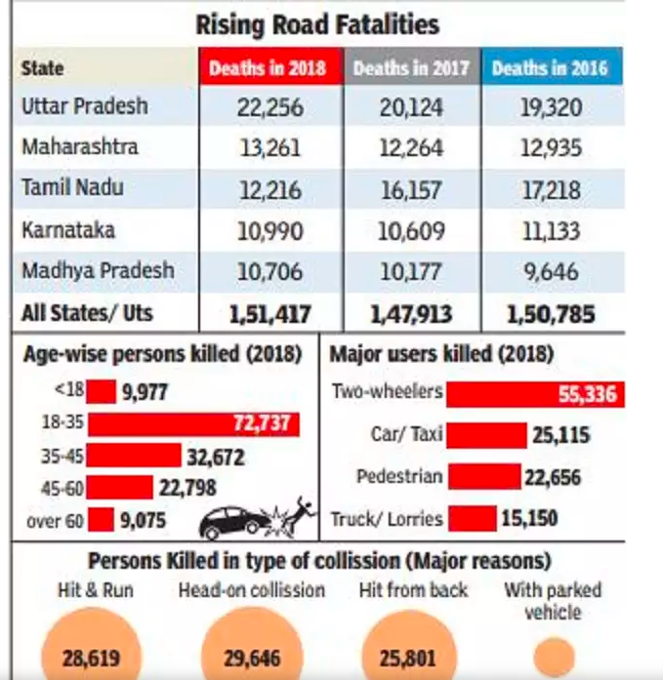
Table

Slide 5
The search for the causes of accidents has been concentrated on environmental factors for the most part, with control programs aimed largely at eliminating or -safety-proofing physical hazards
While there is no doubt that this approach is essential to accident prevention, it has become increasingly evident that accidental injuries and death continue to occur regardless of such environmental control
ACCIDENTS AS SOCIAL PATHOLOGY
Accidents as a social phenomenon may be classified as a form of social pathology
Viewing accidents as symptomatic of social and personal disorder, MacIver (1961:71) claims that "accidents have a significance beyond themselves. They are always symptomatic of disorder in a particular dynamic system . . . the occurrence of accidents . . . is an unerring signal that something or someone is not functioning properly."

Slide 6
ACCIDENTS AS SOCIAL PATHOLOGY
Porterfield (1960) has demonstrated that the accident rate is significantly associated with other indices of social pathology, such as suicide, homicide, and crime.
He characterizes motor vehicles, which constitute the most important single agent of accidental injuries and death, as "deadly weapons" and sees them as a reflection of an underlying social pathology.
To some extent accidents, like suicides and homicides, may represent "the socialization of aggression" (Gold, 1958)
Haddon et al. (1964:446) suggests that accidents "are dysfunctional to the social system, interfering with its smooth operation."

Slide 7
ACCIDENTS AS SOCIAL PATHOLOGY
Several studies have found that individuals from broken homes are more likely to be involved in accidents (Krall, 1953), while Kurokawa (1967) found that children in families with higher cohesion and belief in tradition were less likely to have accidents than children in families not so well-integrated
Every day the newspapers carry stories of accidental automobile crashes, shootings, drownings, stranglings, etc., and this form of violence has become so commonplace that its full import often goes unrecognized and unreported
The current increase in the frequency of death and injuries resulting from accidents has been regarded as a reflection of the violent age in which we live. Such violence is often interpreted to result from a breakdown in social controls

Slide 8
ACCIDENTS AS SOCIAL PATHOLOGY
Foote (1961) attributes much of the current high rate of childhood accidents to the strong emphasis in American society on violence as depicted in mass media. He also raises the interesting question of how many childhood accidents are likely the result of "deliberate parental aggression”.
Another approach to accidents as social pathology attempts to analyze such accidents as a form of deviant behavior
For example, as stated by Hacker and Suchman (1963:388), "Concepts from the sociology of deviance may also be usefully applied to accident research. To the extent that the community has institutionalized certain safe modes of behavior, departures from these may be viewed as aberrant behavior."
Patterson also views accidents as a form of deviant behavior and hypothesizes that there is a threshold of conforming behavior beyond which an individual enters into accident-inducing situations.

Slide 9
ACCIDENTS AS SOCIAL PATHOLOGY
These thresholds are established by the social group in terms of accepted patterns of safe and unsafe behavior. "Repeated accidents may thus be a symptom of individual deviance from a group norm of safe behavior" (Patterson, 1950:68)
To the extent that the group norm has been established to protect the individual from environmental dangers, this is probably true. As has been pointed out previously, however, group norms favoring violence and the taking of risks may actually expose the individual to greater accident hazards
Undoubtedly, a large number of social controls do serve the function of protecting the individual from harm. For example, the many safety devices introduced into high-risk occupations, or the safety features of a children's playground, may be attempts to reduce the exposure of the individual to unplanned and dangerous events in his environment

Slide 10
ACCIDENTS AS SOCIAL PATHOLOGY
Social controls may also serve to regulate hazardous consumer products, such as poisons and lethal weapons. Obviously, a great many social controls-traffic laws and safety regulations, for example- are aimed directly at reducing harmful anti-social behavior.
To the extent that these social controls are violated by the individual, we may hypothesize that he places himself in a situation of additional risk of injury or death.
Several studies have shown that individuals who have frequent accidents are far more likely to have court records of law violations; than individuals with fewer accidents (Siebrecht and Bennett, 1954; Mc- Farland and Moseley, 1954)
As Ross (1960-61) has pointed out, social controls do not operate very successfully in regard to traffic law violations. He classifies violations of such laws as "folk crimes"- crimes that are ignored or even condoned.

Slide 11
ACCIDENTS AS SOCIAL PATHOLOGY
A number of studies designed to measure a wide range of personality traits have compared individuals whose accident-frequency rate is high with those whose rate is low.
While these studies show wide variations in personality factors related to the frequency of accidents, there does seem to be some agreement on the generally antisocial nature of the accident repeater.
Schulzinger (1956) found that accidents were more likely to occur among aggressive individuals, especially among those who were "irresponsible-maladjusted. "
A commonly accepted concept in the accident research field (Mc- Farland, 1966:107) is that "a man works (or drives or plays) as he lives."
A hostile, aggressive, impulsive individual placed in a situation that requires constant attention, self-control, consideration of others, and respect for laws and regulations such as in the driving of an automobile is more susceptible to having an accident

Slide 12
ACCIDENTS AS SOCIAL PATHOLOGY
Bauer (1955), in an analysis of automobile accidents among young people, concludes that many tend to use automobiles to act out the tensions and latent aggressions underlying their rebellion against social controls
Other studies of youth, among whom automobile accidents are the largest cause of injury and death, have characterized the automobile as a symbol of freedom and escape from parental and social authority (McFarland and Moore, 1960)
Murray (1954) also comes to the conclusion that automobile accidents among youth are an expression of hostility, emotional conflict, and rebellion against authority.

Slide 13
ACCIDENTS AS SOCIAL PATHOLOGY
Finally, a large number of studies of childhood accidents indicate that children having frequent accidents also are more likely to be "problem children" and to show aggressive, impulsive behavior and emotional instability (Suchman and Scherzer, 1960).
Accidents are destructive and do not occur by chance. There is ample evidence to show that accidents are more likely to occur ;among certain subgroups of the population-males, young people, and Negroes-and among certain types of personalities the hostile, the aggressive, and the impulsive.

Slide 14
Findings
Frequency of Accidental Injuries. High school students are somewhat more likely to report having had an accident during the previous year than are college students (30.2% vs. 22.9% reporting at least one accident). The average rate of about 26.5 accidents per 100 students is quite similar to the rate of 29.1 reported by the National Health Survey for the age group 15 to 24 (National Safety Council, 1966).
The only demographic variable showing a significant relationship to frequency of accidental injuries is sex. Among the college students, twice as many males as females (11.2% vs. 5.1%) reported two or more injuries during the past year; among the high school students, males were some-what more than twice as likely as females to report two or more injuries during the past year (16.0% vs. 6.4% ).

Slide 15
Findings
The data support the hypothesis that the more deviant an individual is, the more likely he is to have an accident. Such deviance represents a rejection of the "safe and sane" in favor of the nonconventional and increases the individual's risk of having an accidental injury.
Rejection of society means rejecting the many protective measures that society has developed to enhance its survival. The deviant chooses to expose himself to an unconventional environment lacking many of these built-in protections. Both where and how he lives are apt to be more dangerous.
The basic problem of accident prevention and control among young people is quite similar to the general problem of prevention and control of deviance.

Slide 16
Findings
The goal, perhaps, is not to change these rebellious students into inhibited, compulsive young men and women, but rather to increase their capacity for tolerating stress and to permit creativity with a great degree of self-control and awareness of the consequences of their actions upon themselves and others.
Moreover, rigorous enforcement and punishment would not seem to be the answer, especially among these nonconforming young people whose behavior most needs safety regulation, but who, at the same time, are most likely to resist such official control.
Difficult as it may seem, one avenue, that holds some promise of success could come from the young people themselves.

Slide 17
Findings
Conventional driver-training courses are not succeeding, and safety-proofing automobiles and highways can have only a limited impact on the overall rate of accidental injuries.
Perhaps it is only as young people redefine their world for themselves and as we give to them, and they accept, the responsibility for making it a world that they feel is worth living in that they will establish norms of behavior that will help them to stay alive in.

